Slide 1

EDA of 1000 Movies Dataset
by Vaibhav Javadekar

Slide 2
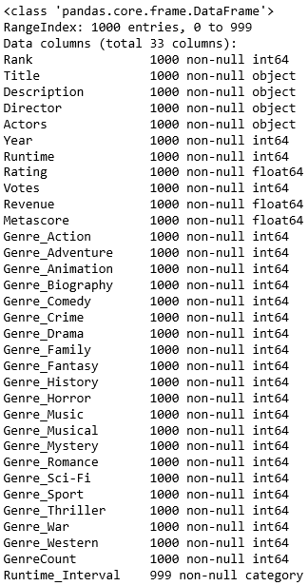
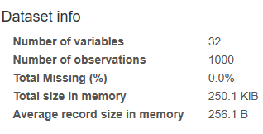
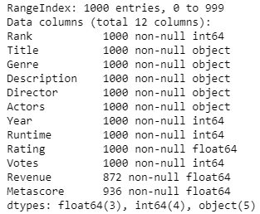
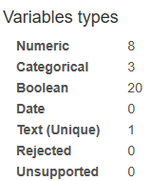
Little information about Dataset

Slide 3
Analysis by Genre

Slide 4
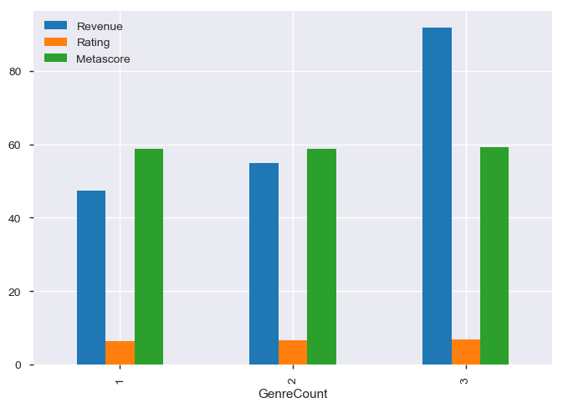
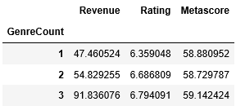
What is the impact of Genre count on Revenue, Ratings and Metascore ?
Above are all mean values
Observation : If movies have 3 Genre count then the revenue is doubled. Ratings and Metascores are also increased but not much significant

Slide 5
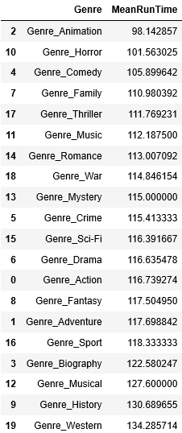
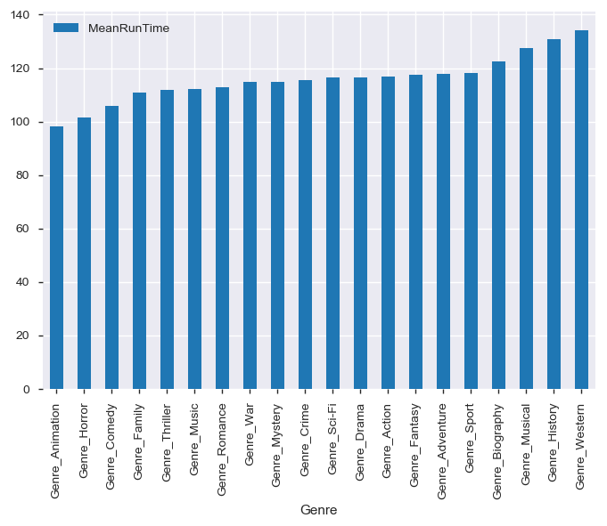
What is the impact of Genre on Runtime ?
Observation : Average Runtime of Movies with Genre Western is maximum around 134 mins followed by History, Musical etc.

Slide 6
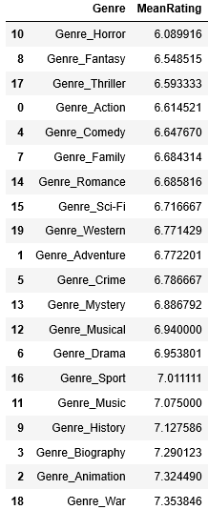
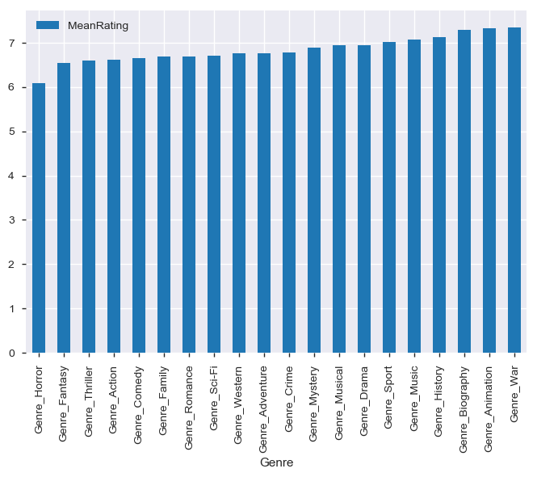
What is the impact of Genre on Rating ?
Observation : Movies with Genre War and Animation has received more average ratings.

Slide 7
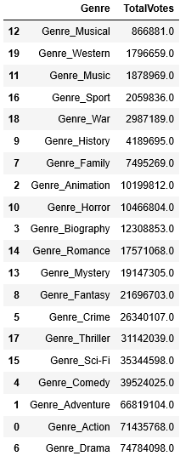
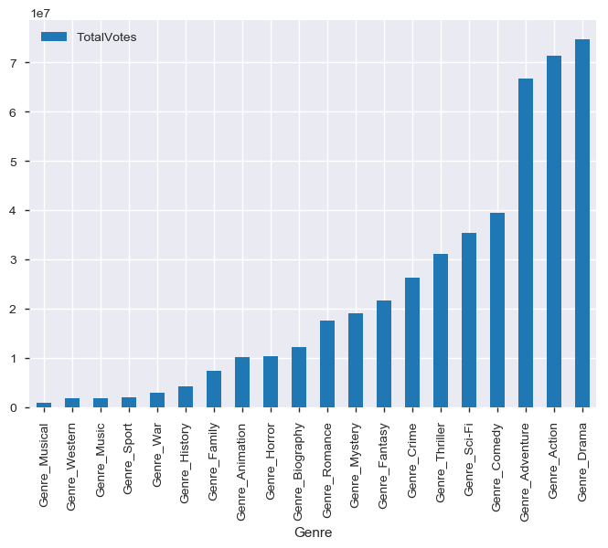
What is the impact of Genre on Votes ?
Observation : Movies with Genre Drama are most liked by users.

Slide 8
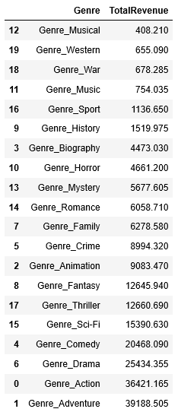
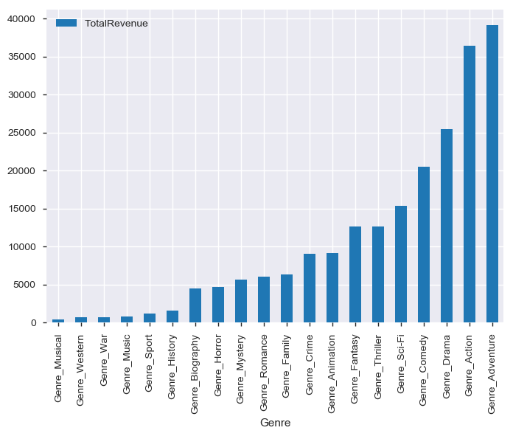
What is the impact of Genre on Revenue ?
Observation : Movies with Genre Adventure , Action, Drama constitute more towards revenue generation in the industry

Slide 9
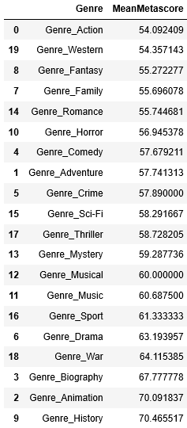
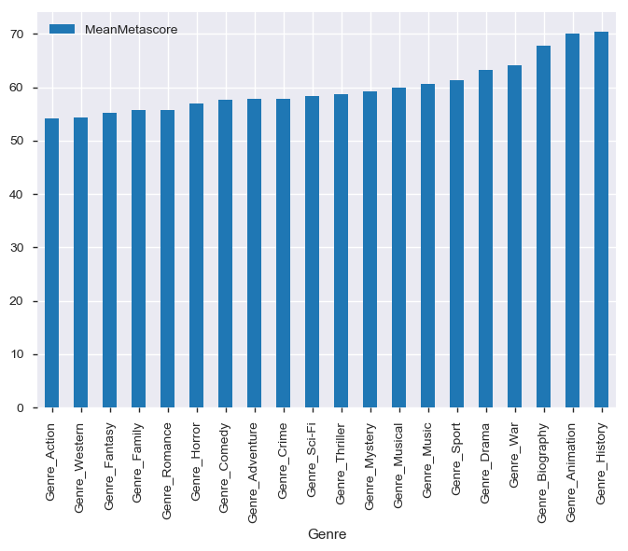
What is the impact of Genre on Metascore ?
Observation : Surprisingly Movies with Genre History, Animation, Biography have received more critic scores

Slide 10
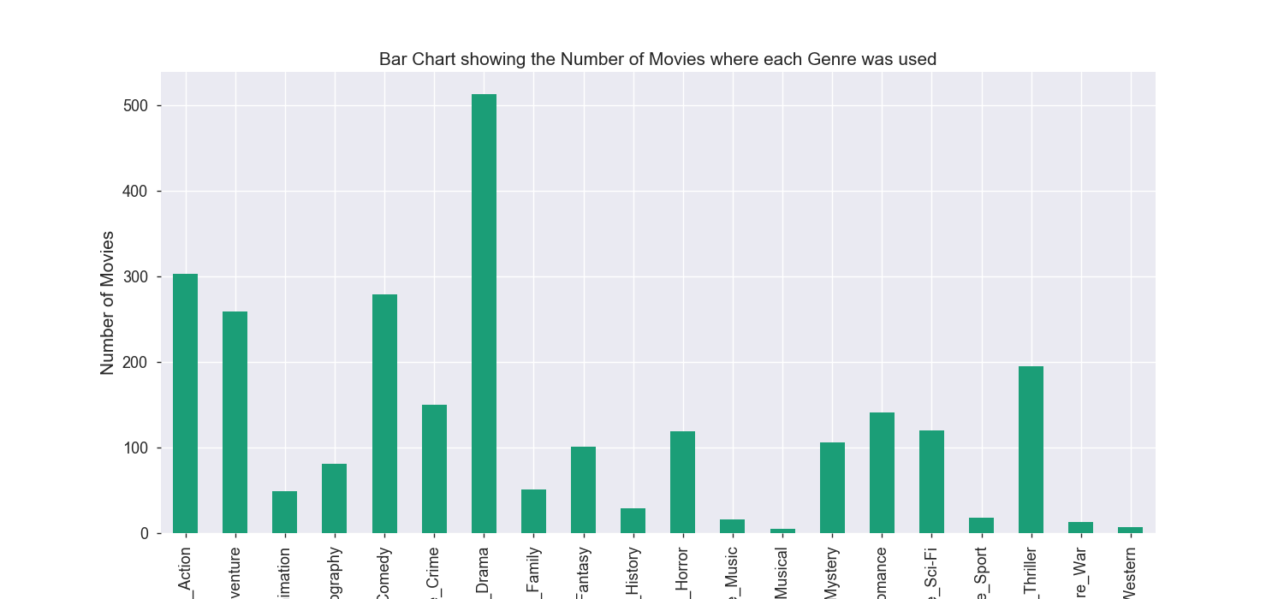
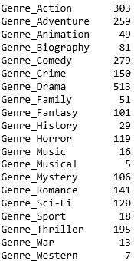
Which Genre Movies are most produced ?
Observation : ‘Drama’ Genre is most produced

Slide 11
Analysis by Director

Slide 12
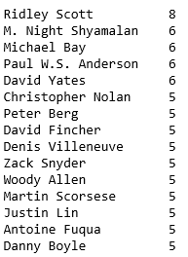
Who are most active Directors ?

Slide 13
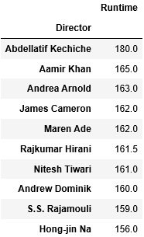
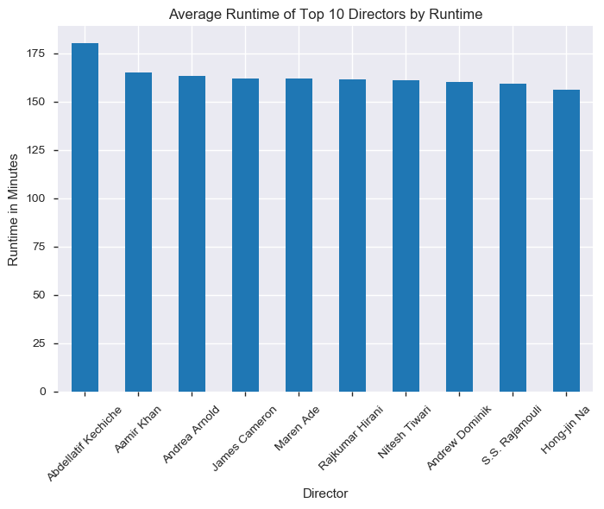
Top 10 Directors and Duration of movies they produced
Observation : In general movies directed by Abdellatif Kechiche are Long movies.

Slide 14
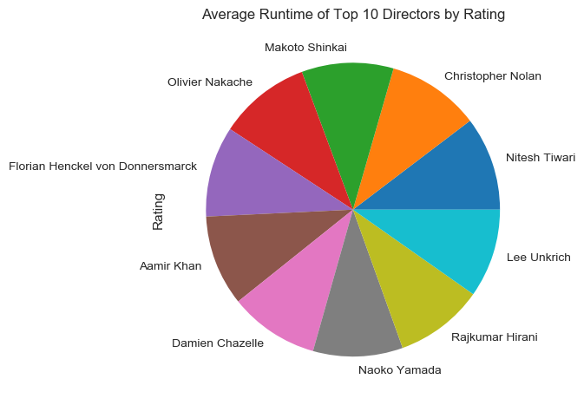
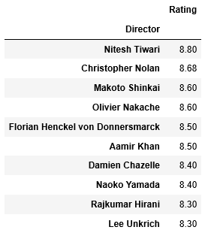
Top 10 Directors and Rating of movies they produced
Observation : Almost all the top 10 directors has similar ratings

Slide 15
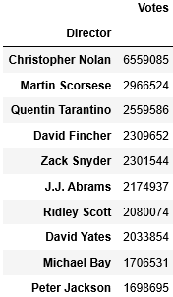
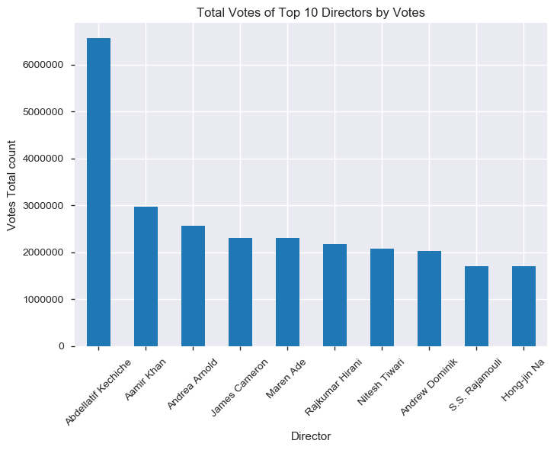
Top 10 Directors and People Votes received
Observation : Movies directed by Christopher Nolan are most liked by viewers

Slide 16
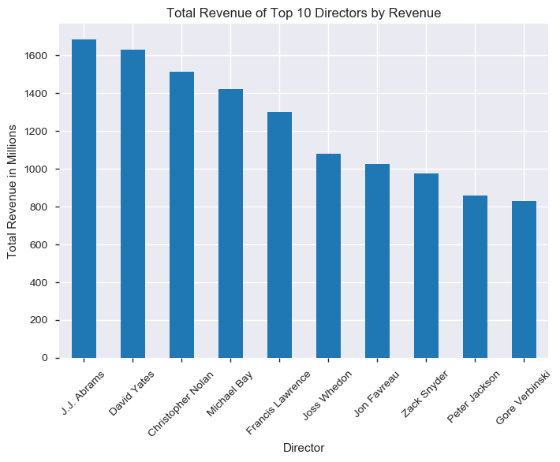
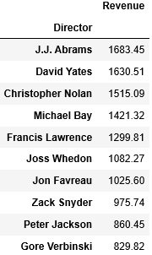
Top 10 Directors and Revenue generated
Observation : Movies directed by JJ Abrams, David Yates , Christopher Nolan etc help more towards Revenue Generation in the industry

Slide 17
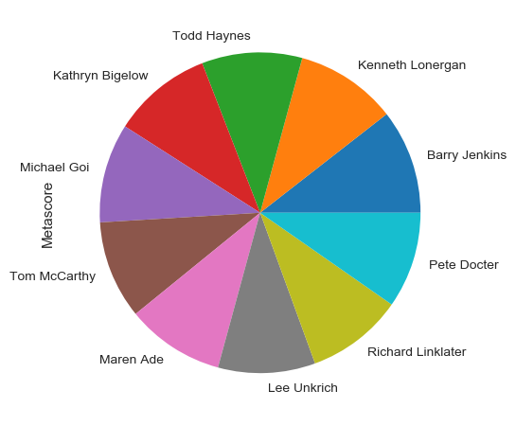
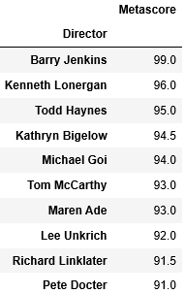
Top 10 Directors and Metascores received
Observation : Movies directed by Barry Jenkins have received more Critic scores but there is not much difference as compared to movies by other directors.

Slide 18
Analysis by each Year

Slide 19
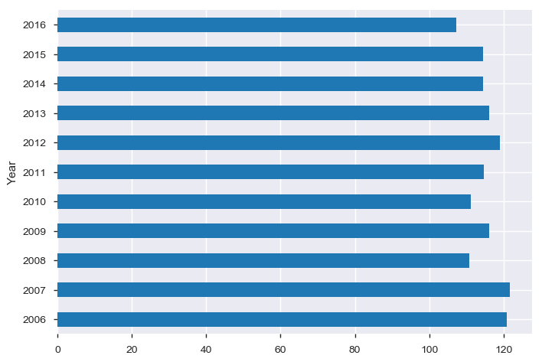
Each Year average runtime of movies
Observation : We can see that average duration of movies produced in 2006 is highest and gradually it is reduced in 2016

Slide 20
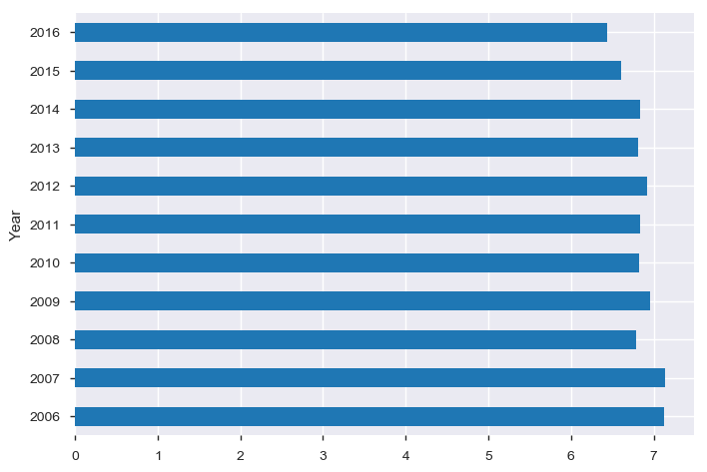
Each Year average Ratings of movies
Observation : Surprisingly the trend of ratings received is seen gradually reduced in 2016 as compared to 2006

Slide 21
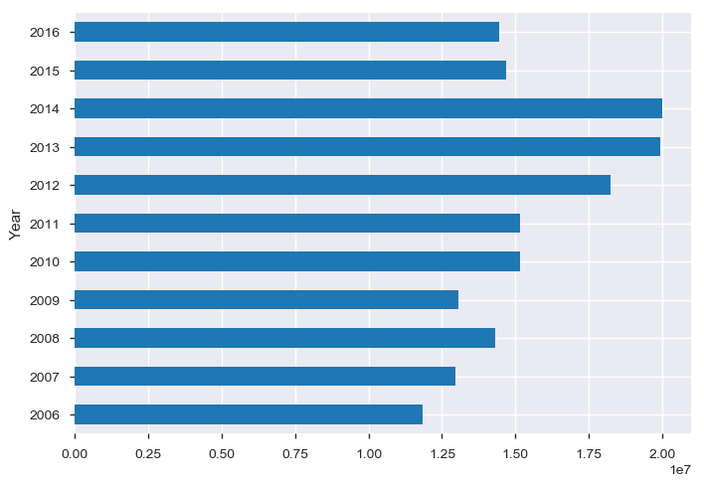
Each Year total Votes on movies
Observation : People did vote in 2013 and 2014 more. Voting since then is reduced gradually.

Slide 22
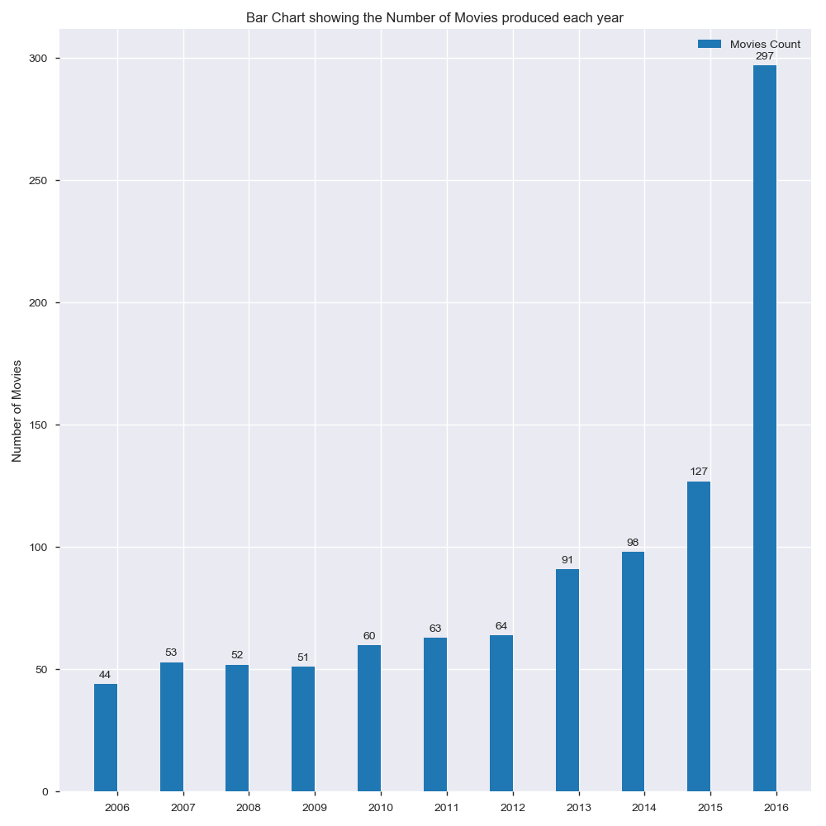
What are total number of movies produced each year ?
Observation : The trend for movies production is increasing year on year
Year | No Of Movies
2016 | 297
2015 | 127
2014 | 98
2013 | 91
2012 | 64
2011 | 63
2010 | 60

Slide 23
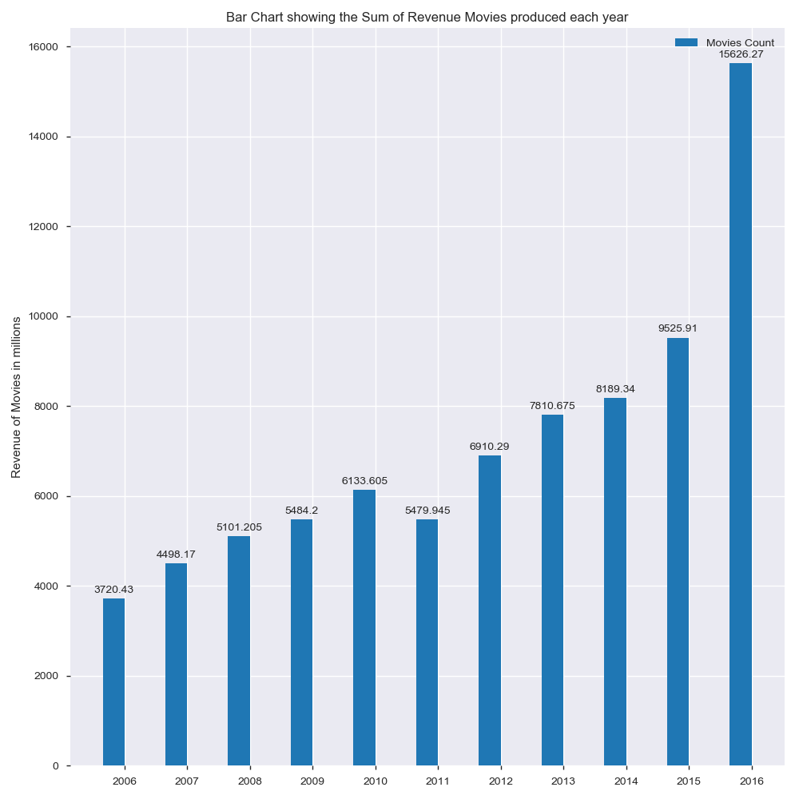
Which year has the highest revenue ?
Observation : Revenue of movies in industry is increasing year on year
Year | Revenue in Millions
2016 | 15626.27
2015 | 9625.91
2014 | 8189.34
2013 | 7810.675
2012 | 6910.29
2011 | 5479.945
2010 | 6133.605

Slide 24
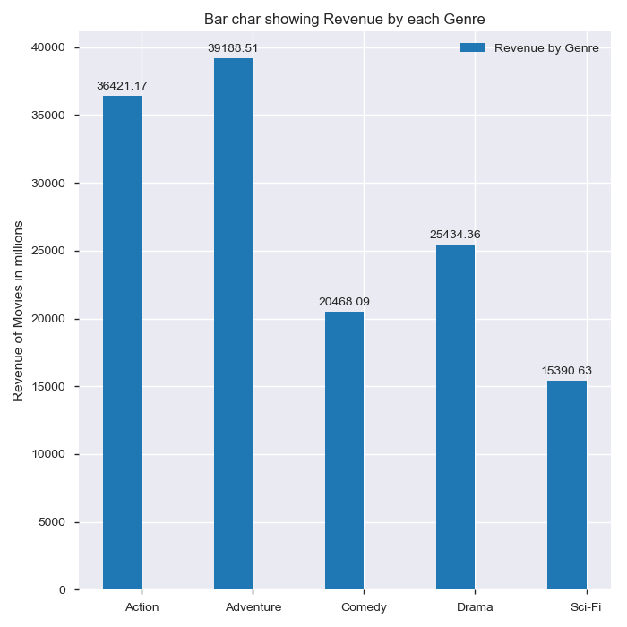
Which Genre Movies are help most in revenue making ?
Genre | Revenue in Millions
Action | 36421.17
Adventure | 39188.0
Comedy | 20468.09
Drama | 25434.36
Sci-Fi | 15390.63
Showing Top 5 Genres only
Observation : Genre Adventure, Action, Drama, Comedy are the leading Genre to help with revenue.

Slide 25
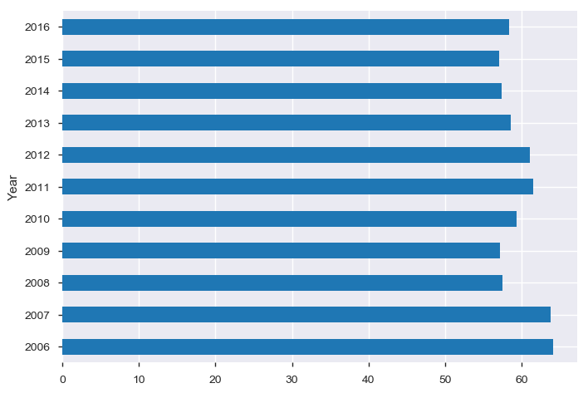
Average Metascores received each Year
Observation : Even critic review scores are also reduced in 2016 as in 2006.

Slide 26
Analysis by Movie Duration

Slide 27
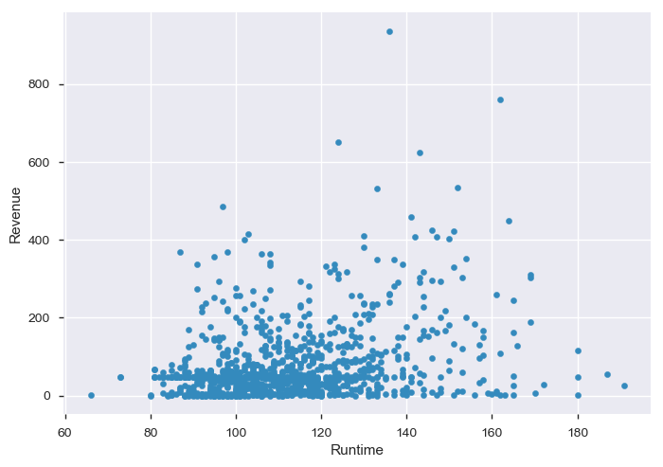
Which duration of movies produce more revenue ?
Observation : Scatter plot shows that most movies produced in runtime duration 100 mins to 120 mins. Let us see how much is the revenue sum generated when duration is categorized.

Slide 28
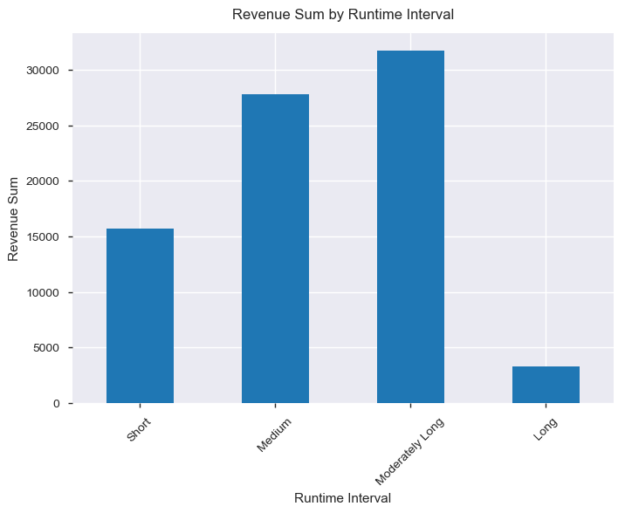
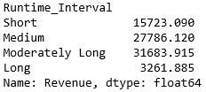
Observation : Medium and Moderately Length movies tend to generate more Revenue

Slide 29
Actionable Insights
Produce movies with runtime duration as Medium or Moderately Long
Produce movies with 3 or more Genre in a single movie
Produce movies with Active directors E.g. If we check the outcome of 2.2(Rating), 2.3(Votes), 2.4(Revenue) and 2.1.1(Active Directors) then we get the common name 'Christopher Nolan'
Since we see that movies production is on rise every year there is lot of competition in the industry, so It is advised to produce multiple movies in year instead of waiting for 1 big single movie.

